Slide 1
DreamFusion : Text-To-3D using 2D Diffusion
CVPR 2022
Ben Poole, Ajay Jain, Jonathan T. Barron, Ben Mildenhall
Presented by Beomsoon Park
C&I LAB

Slide 2
Contents
Introduction
Diffusion Models and Score Distillation Sampling
DreamFusion Algorithm
Experiments
C&I LAB

Slide 3
Introduction
C&I LAB

Slide 4
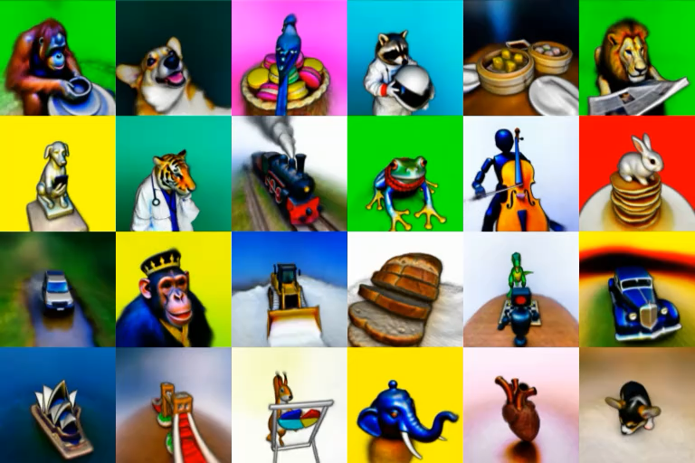
Introduction
DreamFusion
DreamFusion
Text Prompt
Text-To-3D Model using 2D images and text
https://dreamfusion3d.github.io/
C&I LAB

Slide 5
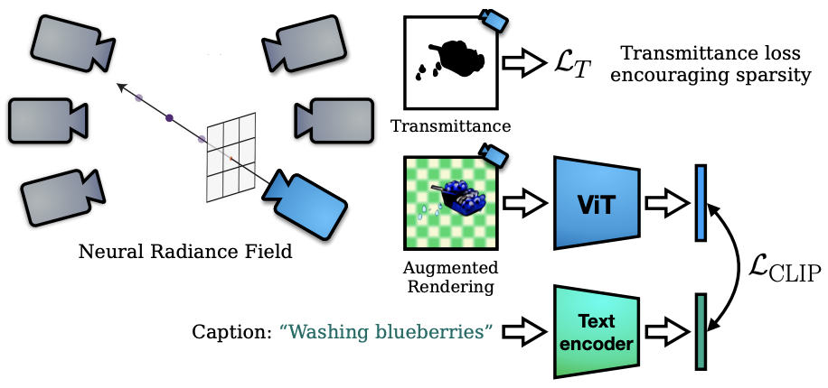
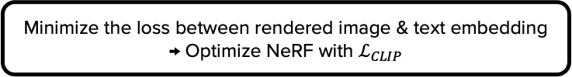
Introduction
Minimize the loss between rendered image & text embedding
→ Optimize NeRF with $ℒ_{CLIP}$
Major Contribution
Dream Fields
NeRF
(Neural Radiance Field)
Pretrained
CLIP
Model
Lacking realism & accuracy
C&I LAB

Slide 6
Introduction
Major Contribution
Suggested Method in DreamFusion
Dream Fields
Pretrained Diffusion Model
Score
Distillation
Sampling
NeRF
(Neural Radiance Field)
Pretrained
CLIP
Model
Optimization
C&I LAB

Slide 7
Diffusion Models and Score Distillation Sampling
C&I LAB

Slide 8
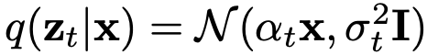
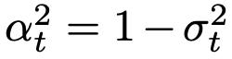
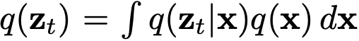
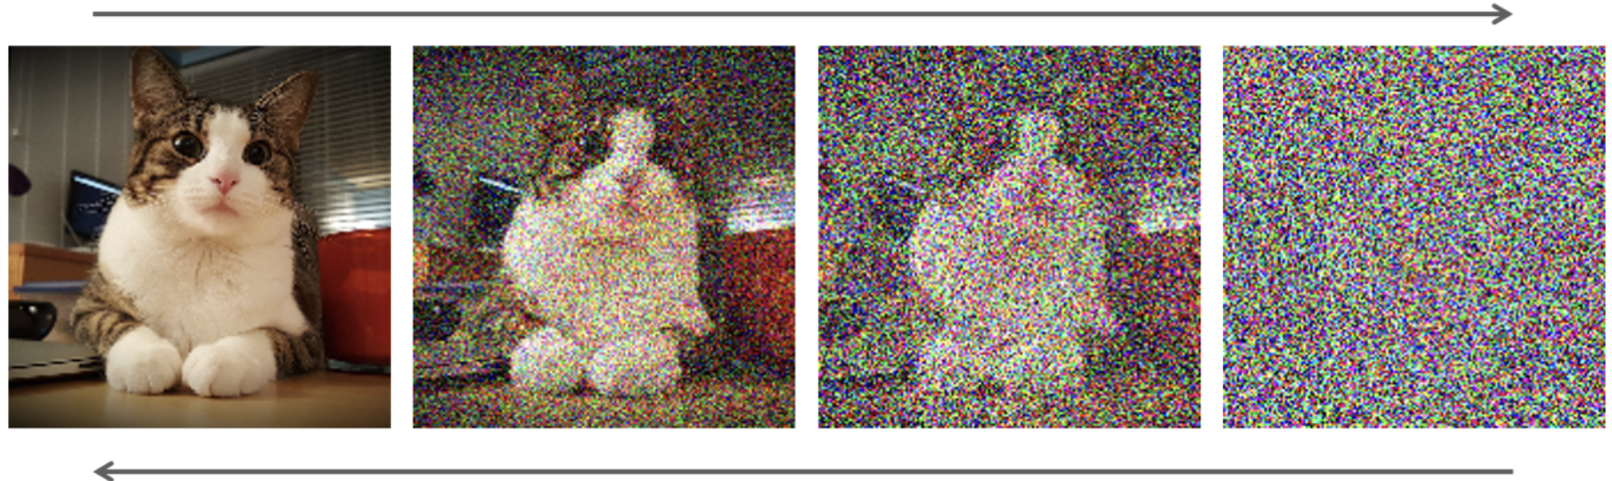
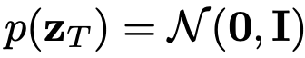
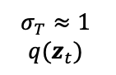
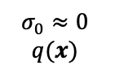
Diffusion Model and Score Distillation Sampling
Diffusion Model Development (Forward and Reverse Process)
$$σ_{0}≈0$$
$$q(x)$$
$$σ_{T}≈1$$
$$q(z_{t})$$
https://developer.nvidia.com/blog/improving-diffusion-models-as-an-alternative-to-gans-part-1/
C&I LAB

Slide 9
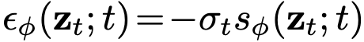
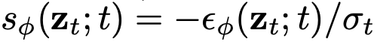
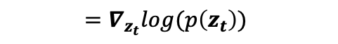
Diffusion Model and Score Distillation Sampling
Diffusion Model Development (Objective & Score Function)
Derived Objective from DDPM
Resembling denoising score matching
$$=∇_{z_{t}}log(p\left(z_{t}\right))$$
C&I LAB

Slide 10
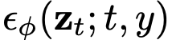
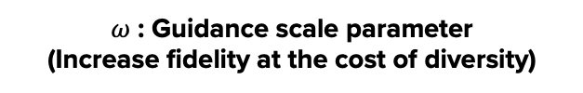
Diffusion Model and Score Distillation Sampling
Diffusion Model Development (Classifier Free Guidance)
Text Embedding (Condition)
$ω$ : Guidance scale parameter
(Increase fidelity at the cost of diversity)
C&I LAB

Slide 11
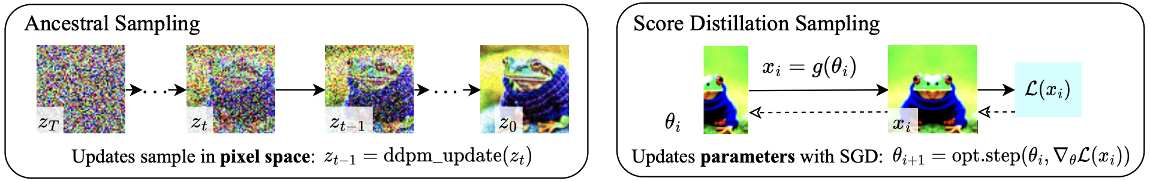
Diffusion Model and Score Distillation Sampling
Score Distillation Sampling
[General Diffusion Model Sampler]
Generate samples by “denoising” noisy images
[Score Distillation Sampling]
Generate samples by “updating parameters” being utilized for image generation
(Performed in parameter space)
(Performed in pixel space)
C&I LAB

Slide 12
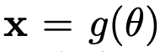
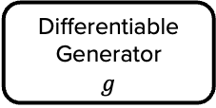
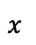
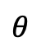
Diffusion Model and Score Distillation Sampling
DIP (Differentiable Image Parameterization)
Purpose
Well-performing 3D Model which create seemingly good images
when rendered from random angles
Advantage
More available optimization algorithms
Not constrained to specific resolution (Flexibility)
Differentiable Image Parameterization
Differentiable Generator
$$g$$
$$θ$$
$$x$$
Parameters
(3D Volume parameters)
Rendered Image
Volume Renderer
C&I LAB

Slide 13
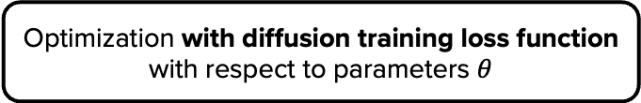
Diffusion Model and Score Distillation Sampling
Score Distillation Sampling
Utilize DIP
for sampling with pretrained diffusion sampler
How to apply DIP to diffusion model?
Optimization with diffusion training loss function
with respect to parameters $θ$
Unrealistic Samples
(Other loss functions are also brittle and generate undesirable samples)
Low loss → Plausible Image
High loss → Implausible Image
C&I LAB

Slide 14
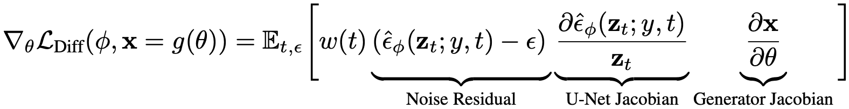
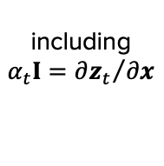
Diffusion Model and Score Distillation Sampling
Score Distillation Sampling
including
$$α_{t}I={∂z_{t}}/{∂x}$$
Expensive Computation
→ Backpropagation through U-Net
C&I LAB

Slide 15
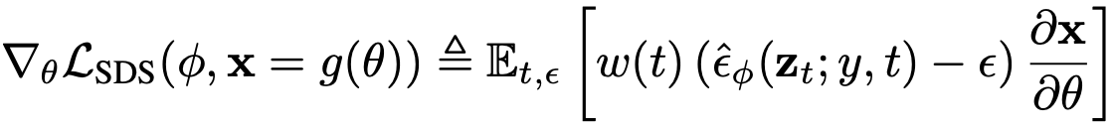
Diffusion Model and Score Distillation Sampling
Score Distillation Sampling
Score Distillation Sampling
→ Gradient for learning DIPs with diffusion models
C&I LAB

Slide 16
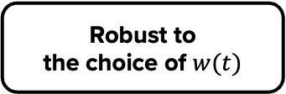
Diffusion Model and Score Distillation Sampling
Score Distillation Sampling
Weighted Probability Density Distillation Loss
Score Distillation Sampling Loss
Easy Implementation
Robust to
the choice of $w(t)$
No backpropagation through U-Net required
C&I LAB

Slide 17
DreamFusion Algorithm
C&I LAB

Slide 18
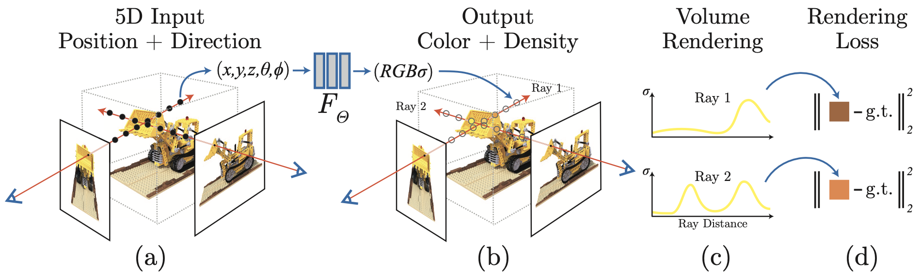
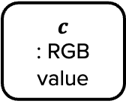
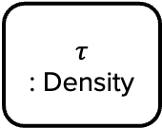
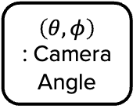
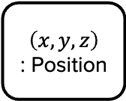
DreamFusion Algorithm
Prerequisite – NeRF (Neural Radiance Field)
$$\left(x, y, z\right)$$
: Position
$$\left(θ, φ\right)$$
: Camera Angle
Fully-Connected Layer
$$τ$$
: Density
$$c$$
: RGB value
C&I LAB

Slide 19
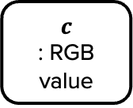
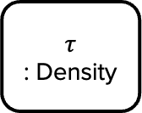
DreamFusion Algorithm
Prerequisite – NeRF (Neural Radiance Field)
$$τ$$
: Density
$$c$$
: RGB value
Weight for each 3D sample points
Expected Color
Alpha-Composition
Determine Opacity
C&I LAB

Slide 20
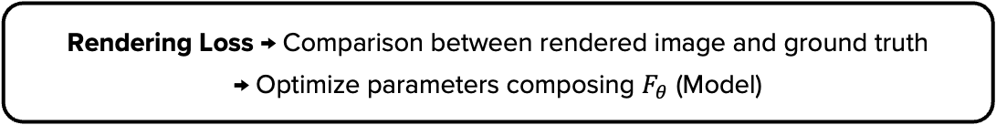
DreamFusion Algorithm
Prerequisite – NeRF (Neural Radiance Field)
Rendering Loss → Comparison between rendered image and ground truth
→ Optimize parameters composing $F_{θ}$ (Model)
C&I LAB

Slide 21
DreamFusion Algorithm
Prerequisite – NeRF (Neural Radiance Field)
Expectation from this model
: Good performance with unobserved camera angles
Recent 3D models
are based on this model
C&I LAB

Slide 22
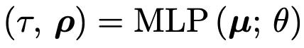
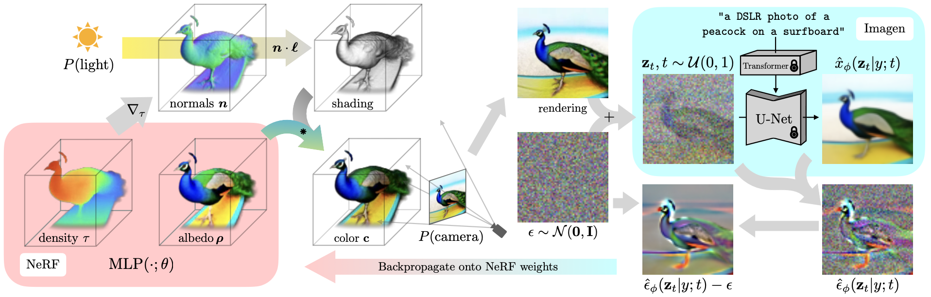
DreamFusion Algorithm
3D sample
(position)
Camera
(Ray Direction)
DreamFusion
≈
Color of the surface itself
Radiance (Original NeRF output)
C&I LAB

Slide 23
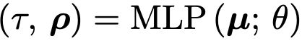
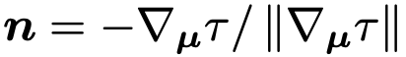
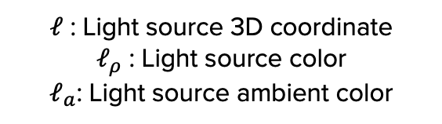
DreamFusion Algorithm
DreamFusion
Normal Vector
(Local orientation of object’s geometry)
$ℓ$ : Light source 3D coordinate
$ℓ_{ρ}$ : Light source color
$ℓ_{a}$: Light source ambient color
C&I LAB

Slide 24
DreamFusion Algorithm
DreamFusion
Color = Combination of albedo and shading
Albedo
(Surface Color)
Aligned distance
between light source and object
Original light source color
Ambient light color
(Diffuse Reflectance)
C&I LAB

Slide 25
DreamFusion Algorithm
DreamFusion (Additional Constraints for better rendering)
Scene Structure
Querying NeRF scene representation
with a fixed bounding sphere
Better single object generation
Composite rendered ray color on top of generated background color
Help paint only appropriate region
Geometry Regularizers
Regularization penalty on the opacity along each ray
Prevent unnecessary filling
C&I LAB

Slide 26
DreamFusion Algorithm
DreamFusion (Text-To-3D Synthesis)
≈
① Random Camera & Light Sampling
② Rendering
③ Diffusion Loss with view-dependent conditioning
④ Optimization
C&I LAB

Slide 27
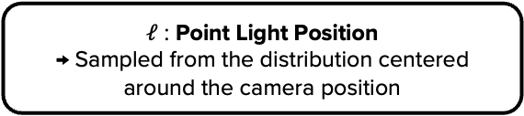

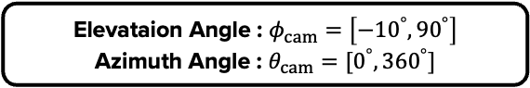
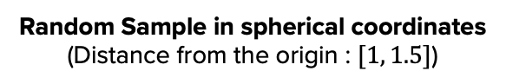
DreamFusion Algorithm
DreamFusion (Text-To-3D Synthesis)
① Random Camera & Light Sampling
≈
Random Sample in spherical coordinates
(Distance from the origin : $[1, 1.5]$)
Elevataion Angle : $φ_{cam}=\left[−{10}^{°}, {90}^{°}\right]$
Azimuth Angle : $θ_{cam}=[0^{°}, {360}^{°}]$
Focal length = $λ_{focal}w$
$λ_{focal}∈𝒰(0.7, 1.35)$ / $w=64$
$ℓ$ : Point Light Position
→ Sampled from the distribution centered around the camera position
C&I LAB

Slide 28
DreamFusion Algorithm
DreamFusion (Text-To-3D Synthesis)
② Rendering
≈
Camera Pose & Light Position from ①
Rendering at 64 X 64 resolution
Input for Imagen Model
(Text-to-Image Model)
C&I LAB

Slide 29
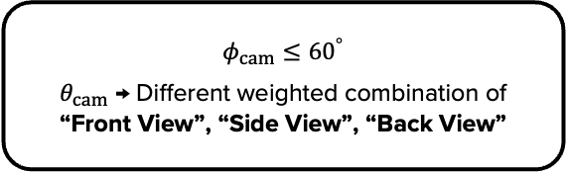

DreamFusion Algorithm
DreamFusion (Text-To-3D Synthesis)
③ Diffusion Loss with view-dependent conditioning
≈
Randomly sampled camera location
Appending view-dependent text to the input text
$φ_{cam}>{60}^{°}$ : Append “Overhead View”
$$φ_{cam}≤{60}^{°}$$
$θ_{cam}$ → Different weighted combination of “Front View”, “Side View”, “Back View”
C&I LAB

Slide 30
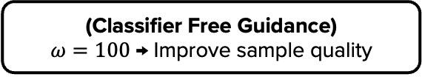
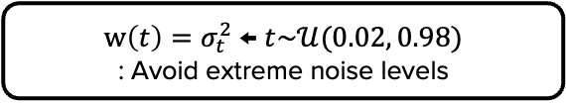
DreamFusion Algorithm
DreamFusion (Text-To-3D Synthesis)
③ Diffusion Loss with view-dependent conditioning
≈
Imagen Model Setting
$w\left(t\right)=σ_{t}^{2}$ ← $t\sim 𝒰(0.02, 0.98)$
: Avoid extreme noise levels
(Classifier Free Guidance)
$ω=100$ → Improve sample quality
Small guidance scaling → Oversmoothing
C&I LAB

Slide 31
DreamFusion Algorithm
DreamFusion (Text-To-3D Synthesis)
④ Optimization
≈
TPUv4 with 4 chips
Each chip
: Render separate views & Evaluate U-Net
15000 iterations for optimization
(1.5 hours)
→ Evenly taken for each task
Optimization performed with
“Distributed Shampoo”
C&I LAB

Slide 32
Experiments
C&I LAB

Slide 33
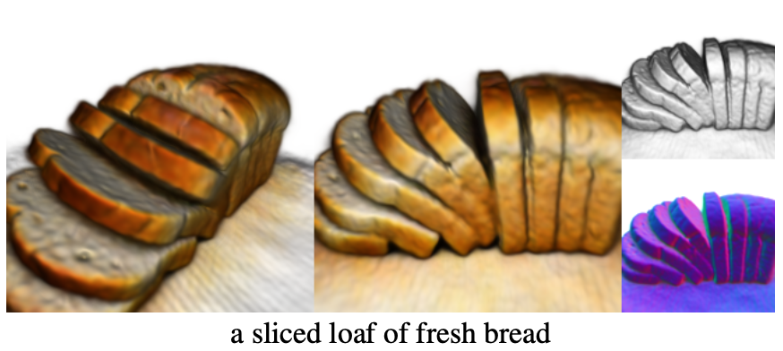
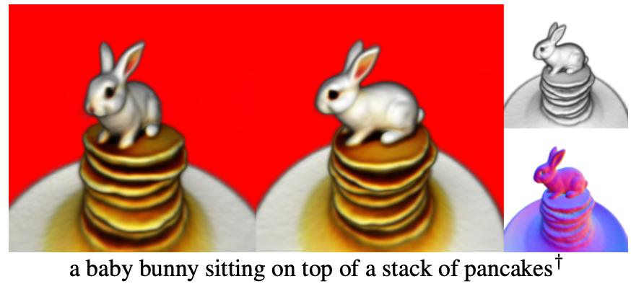
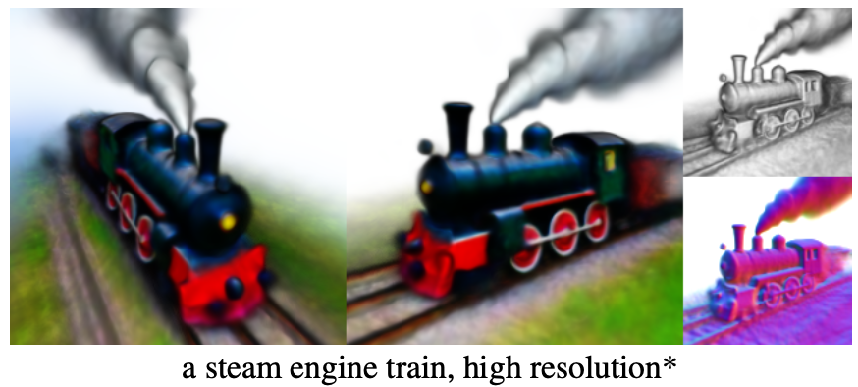
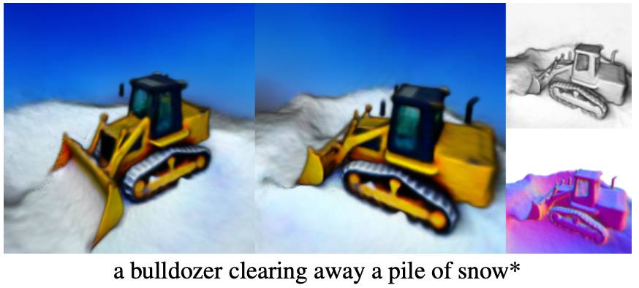
Experiments
Visual Results
C&I LAB

Slide 34
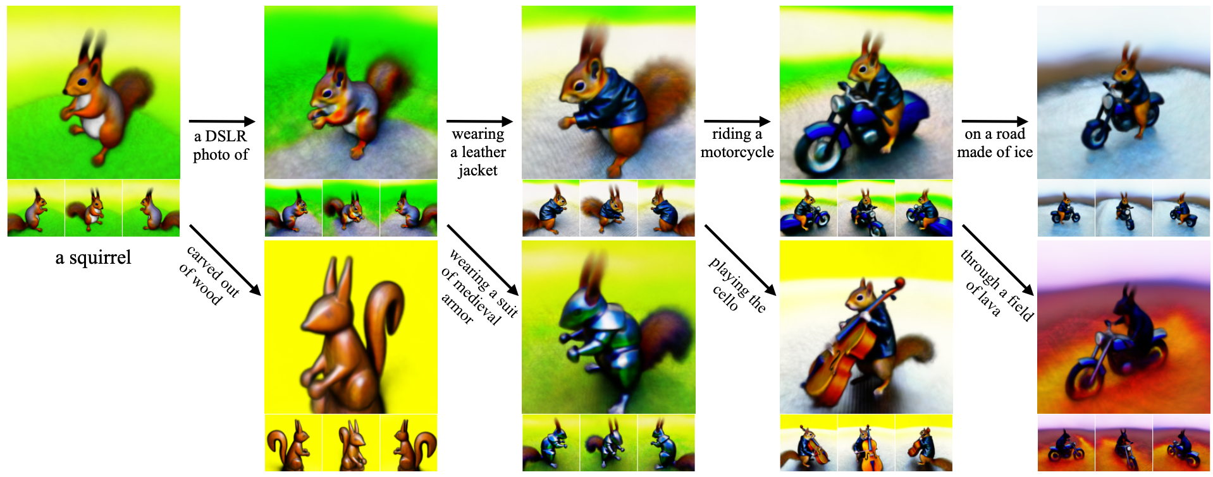
Experiments
Visual Results
C&I LAB

Slide 35
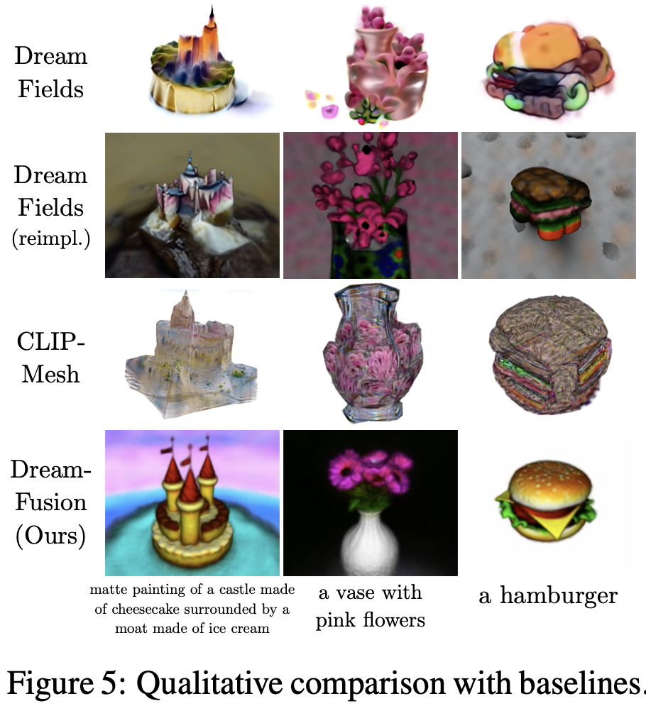

Experiments
Comparison with other models
(Appropriate for zero-shot Text-to-3D model)
Measure the consistency of rendered view with respect to the input caption
C&I LAB

Slide 36

Experiments
Add view-dependent prompts
Textureless Rendering without color
Ablation Study
No view-dependent prompts
Add
Lighting
Albedo
Rendering
Fully-shaded
Rendering
Textureless
Rendering
C&I LAB

Slide 37
Thank you
C&I LAB

